Slide 1
Implementation of weighted parallel hybrid recommender systems for e-commerce in Indonesia Mustika Aprilianti ; Rahmad Mahendra ; Indra Budi ICACSIS, 2016, Malang Indonesia
報告者：陳克威
日 期：2019/06/13
Notes:
International Conference on Advanced Computer Science and Information Systems
2016 印尼(Indonesia)

Slide 2
Outline
Introduction
Model
Data and Experiments
Results and Discussion
Conclusions

Slide 3
Introduction

Slide 4
Introduction
在印尼大型電商越來越多如：Bukalapak, Tokopedia, Elevenia, Blibli.com, Lazada
這些公司希望[用戶]與[交易量]越來越多。
用戶要在大量商品中決定購買哪種商品。
推薦系統：Amazon.com / Ebay.com 使用推薦系統後很成功。
印尼的推薦系統跟其他國家的推薦系統不太相同，可能是因為最受歡迎的商品不同。
本研究使用[ 加權混合推薦系統 ]，結合協同過濾與內容過濾，可以克服兩者的缺點。
Notes:
內容缺點：物品種類太侷限
協同缺點：冷啟動

Slide 5
Model

Slide 6
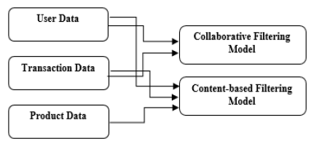
Model
Our study aims to implement and evaluate recommender system by using weighted parallel hybrid approach which is a combination of the two approaches, collaborative filtering and content-based filtering.

Slide 7
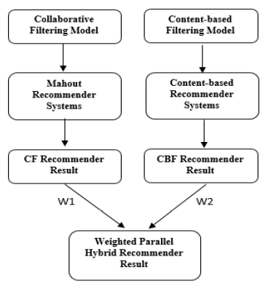
Model
By experimenting weight values W1 and W2,
the hybrid system will generate
the final recommendation result.

Slide 8
A. Collaborative Filtering
In our work, the collaborative filtering approach is implemented using Java programming language and Mahout framework.
(1) User-Based Collaborative Filtering
Computing Similarity: use log-likelihood similarity algorithm in Mahout.
Determining Neighborhood: After experiment, we choose 0.7 as the threshold neighbor value.
Making a Recommendation: Top-N products
(2) Item-Based Collaborative Filtering
Computing Similarity: log-likelihood similarity
Making a Recommendation: Top-N products

Slide 9
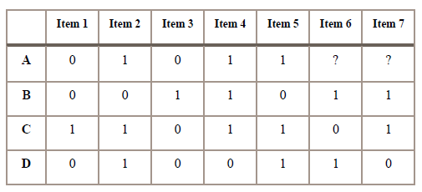
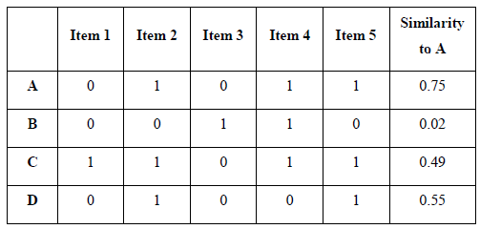
An Example of a Collaborative Filtering
Threshold = 0.5

Slide 10
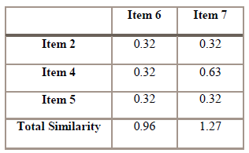
A. Collaborative Filtering

Slide 11
B. Content-Based Filtering
Content-based filtering approach needs two types of data models to produce a recommendation,
namely user-model and item model.
The user-model used in this research is a collection of the names of the products that have been purchased by the user, whereas the item-models only contain the name of the products.
For generating a recommendation, we need to compute similarity between user-model and item-model.
We use cosine similarity formula to compute similarity in content-based filtering approach.

Slide 12
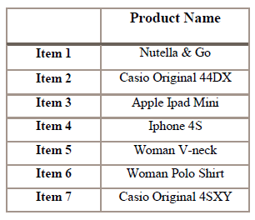

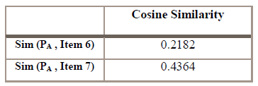
B. Content-Based Filtering
Notes:
產品名稱？
人工標記 產品類別？

Slide 13

C. Weighted Parallel Hybrid
reck(u,i) is the recommendation results from k approach which is given the weight βk.

Slide 14
Data and Experiments

Slide 15
Data and Experiments
The dataset in our experiments was derived from one of the largest C2C e-commerce company in Indonesia.
This data was retrieved from 18-months period, from January 2014 to June 2015.
The dataset was used in training phase and testing phase.
It consists of 1,246 user data, 64,476 transaction data, and 95,468 product data.

Slide 16
Data and Experiments
A. Bootstrapping Validation (bv)
Sampling is performed by separating the testing data and training data randomly from the dataset. Testing data is 30% of the overall transactions done by each user.
B. Timing Series (ts)
This sampling technique obtains the testing data and training data based on the time of purchase (month) in period of 18 months. Testing data contain all transactions from the users who have made purchase during the last 4 months, while the training data is all transaction during the first 14 months.
C. Systematic Sampling (ss)
Systematic sampling is dividing the testing data and training data based on specific interval. We set value 2 as the interval data. Therefore, the training data is taken by odd-index, which is 0th, 2th, 4th and so on.

Slide 17
Results and Discussion

Slide 18
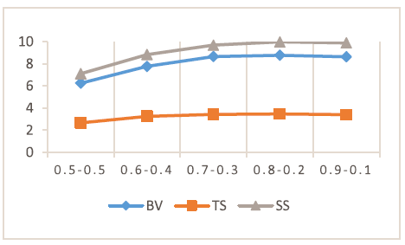
Results and Discussion
Figure 4 shows that combination of 0.8 for collaborative filtering and 0.2 for content-based filtering generates the best result in the experiment phase.

Slide 19
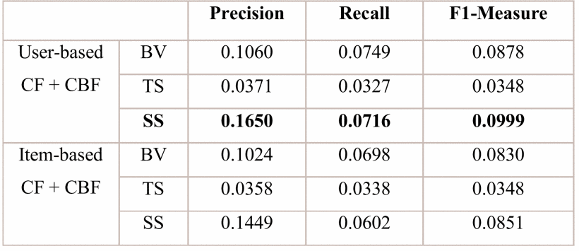
Results and Discussion

Slide 20
Conclusions

Slide 21
Conclusions
Implementation of weighted parallel hybrid approach can be applied to build recommendation system for e-commerce in Indonesia.
In this research, we achieve the highest F1-measure 9.99%.
This evaluation result is not much different with the result from previous research of recommendation system in global scope.
Notes:
加權並行混合方法的實施可以應用於構建印度尼西亞電子商務的推薦系統。
在這項研究中，我們實現了最高的F1 - 測量9.99％。
該評價結果與全球範圍內推薦系統的研究結果差別不大。

Slide 22
Thanks for listening.
報告者：陳克威
日 期：2019/06/13

